Slide 1
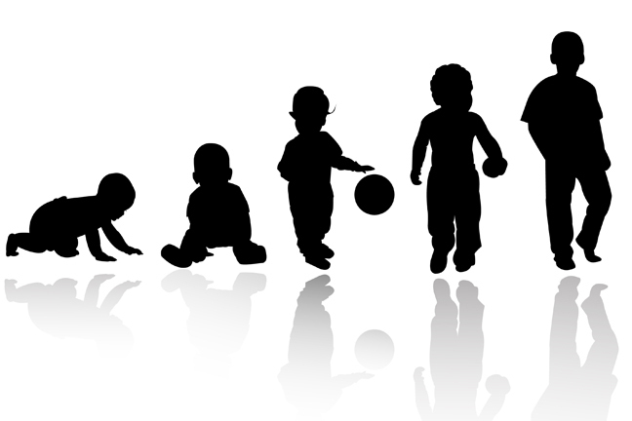
Lifespan Psychology: Childhood
AEPSY Year 11 ATAR Psychology

Slide 2
Review
At which stage of prenatal development does the CNS start to form?
What are newborn reflexes and why are they important?
Why do newborn reflexes disappear as the infant grows and develops?
Give an example of a fine motor skill and a gross motor skill that an infant may demonstrate.
Explain why development is organised and sequential.

Slide 3
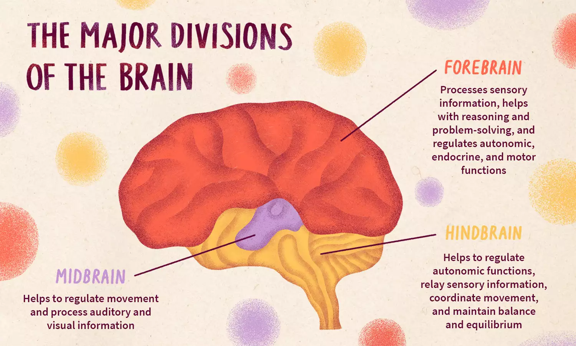
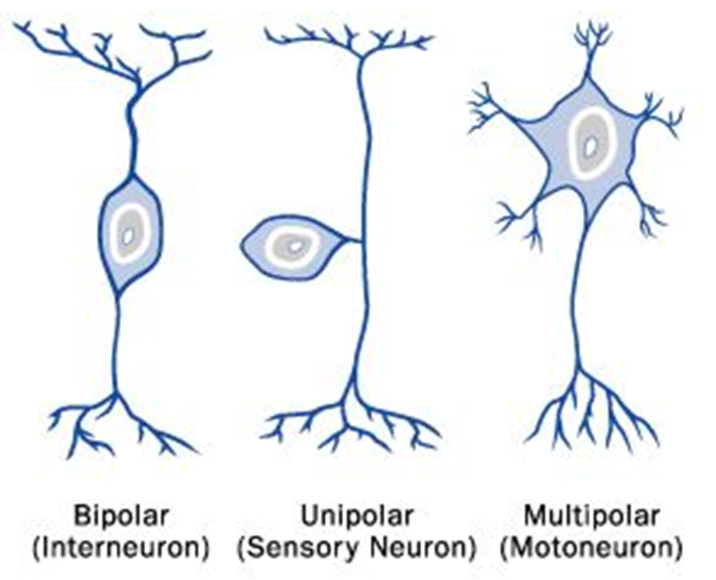
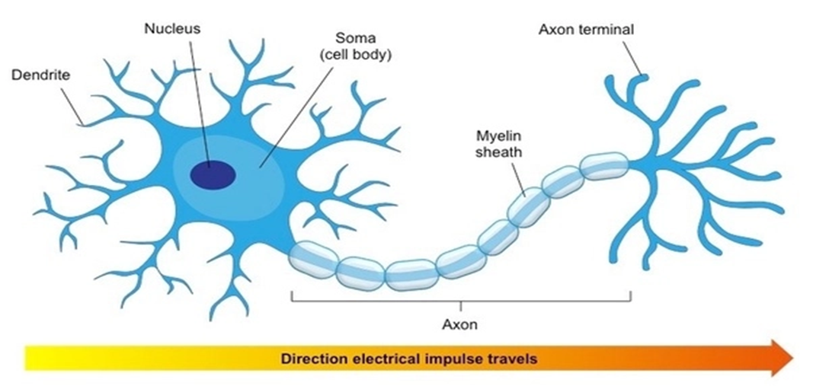
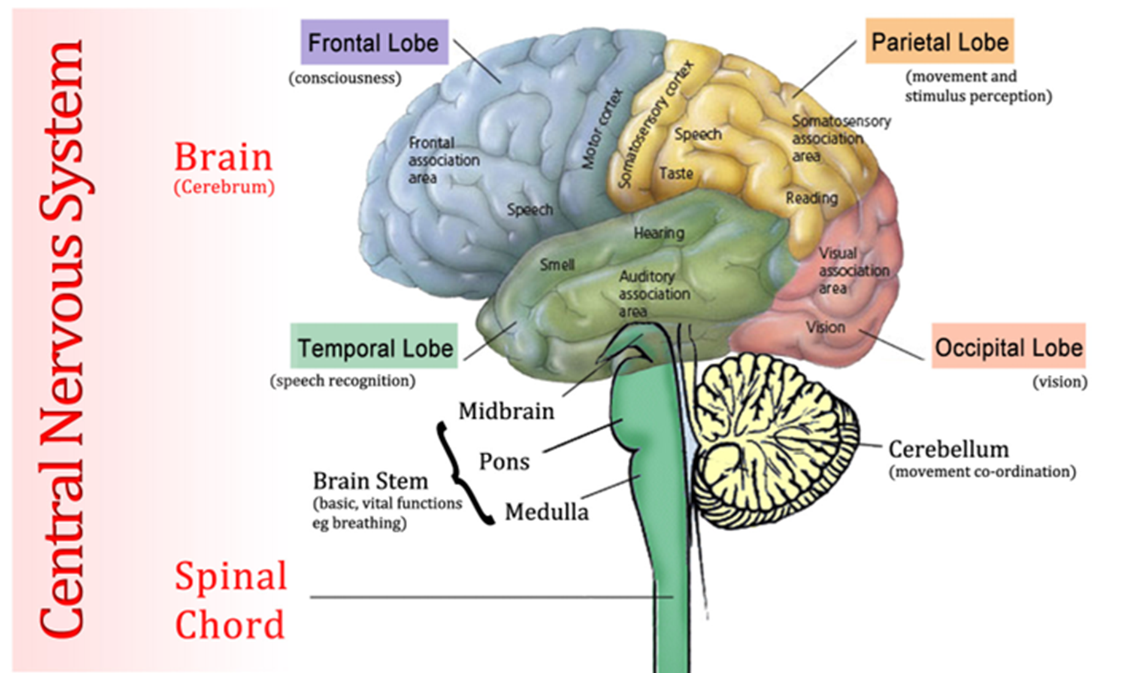
Review
6. Name the four lobes of the cerebellum, and give one example of a function for each.
7. What is the function of the midbrain?
8. Draw a sensory neuron (labelled of course ;)
9. What is the function of a myelin sheath?
10. Describe one population sampling technique.

Slide 4
Learning Intentions
Lifespan psychology
developmental stages across the lifespan – childhood
changes across developmental stages
physical (gross and fine motor skills)
cognitive (language)
social and emotional development

Slide 5
Success criteria
Define neural blooming and neural pruning
Define milestone
Sequence milestones by complexity
Classify milestones as fine motor, gross motor, cognitive or social-emotional
Give one example of each of the above that would be age appropriate for a 1-5 year old

Slide 6
Childhood
Throughout childhood, the nervous system continues to grow and develop. Each neural pathway forms thousands of new connections during infancy and toddlerhood. A period of rapid neural growth is called blooming.

Slide 7
Childhood
The blooming period of neural growth is then followed by a period of pruning, where neural connections are reduced. It is thought that pruning causes the brain to function more efficiently, allowing for mastery of more complex skills.

Slide 8


Slide 9
Milestones
There are certain developmental milestones that young children should achieve. For each milestone there is an average age, as well as a range of ages in which the milestone should be reached. Some developmental delays can be identified and addressed through early intervention.

Slide 10
Developmental Milestones, Ages 2–5 Years
Age (years) | Physical | Personal/Social | Language | Cognitive
2 | Kicks a ball; walks up and down stairs | Plays alongside other children; copies adults | Points to objects when named; puts 2–4 words together in a sentence | Sorts shapes and colors; follows 2-step instructions
3 | Climbs and runs; pedals tricycle | Takes turns; expresses many emotions; dresses self | Names familiar things; uses pronouns | Plays make believe; works toys with parts (levers, handles)
4 | Catches balls; uses scissors | Prefers social play to solo play; knows likes and interests | Knows songs and rhymes by memory | Names colors and numbers; begins writing letters
5 | Hops and swings; uses fork and spoon | Distinguishes real from pretend; likes to please friends | Speaks clearly; uses full sentences | Counts to 10 or higher; prints some letters and copies basic shapes

Slide 11
Activity: Milestones

Slide 12
Success criteria
Define neural blooming and neural pruning
Define milestone
Sequence milestones by complexity
Classify milestones as fine motor, gross motor, cognitive or social-emotional
Give one example of each of the above that would be age appropriate for a 1-5 year old

